Slide 1
The Bar & Grill Case Study
Team BHLC
Thuan Bui
Guoming Lin
Chunyu Huang
Kerry Che

Slide 2
Agenda
Introduction
Business Challenges
Research Methods
Finding Analysis
Implementation Plan
Conclusion

Slide 3
Introduction
Background:
The Bar & Grill is a casual dining restaurant brand founded by a classically trained chef in Henderson, Las Vegas. The concept began with a single location and a simple goal: to build a business the owner could proudly call his own.
Thanks to quality food and a viral boost from a popular YouTuber, the restaurant quickly gained popularity, seeing 40% annual growth. This success led to the opening of five total locations.

Slide 4
Business Challenges
Labor Cost Inefficiencies
Delivery Platforms Profit Loss
Inefficient Accounting Systems
Complicated Cash Management
Fragmented Data Across Stores
Delayed and Inaccurate Reporting

Slide 5
Research Methods
Programming Tools:
Microsoft Excel
Python
R

Slide 6
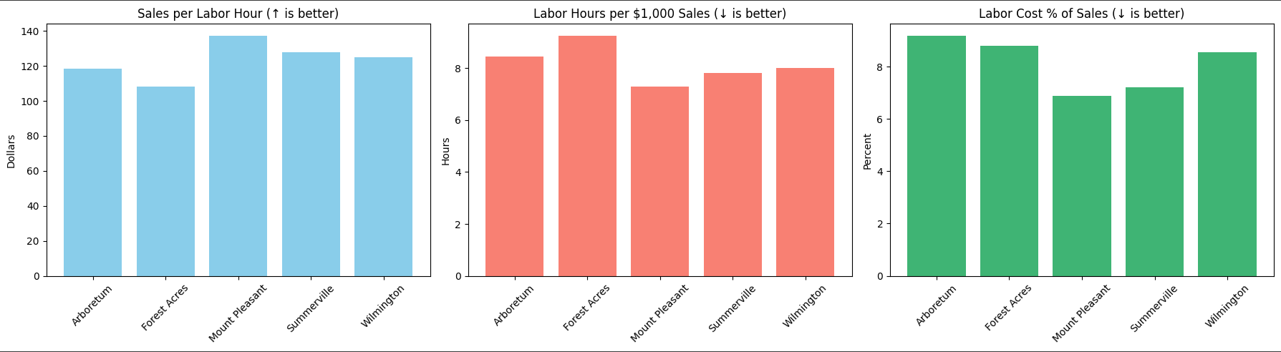
Labor Cost Inefficiencies
Mount Pleasant consistently outperforms on all labor KPIs.
Forest Acres underperforms in productivity, efficiency, and cost.

Slide 7
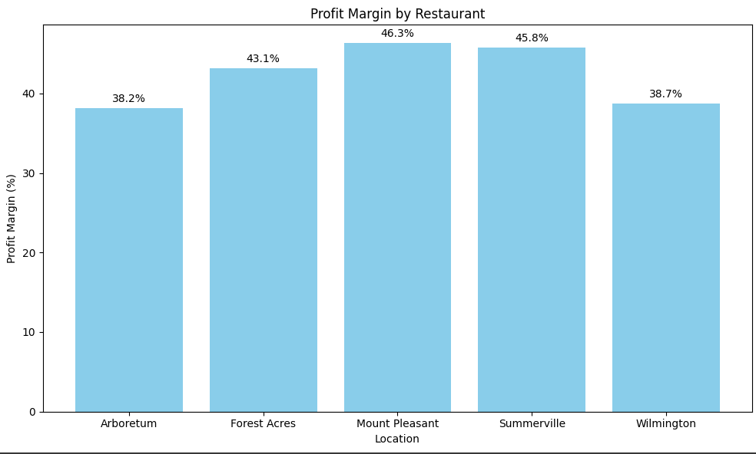
Labor Cost Inefficiencies
Mount Pleasant will be our target benchmark.
Labor Hours per $1,000 Sales = 7.29

Slide 8
Labor Cost Inefficiencies
Category | Arboretum | Forest Acres | Mount Pleasant | Summerville | Wilmington
Sales per Labor Hour | 118.33 | 108.14 | 137.18 | 127.86 | 124.90
Labor Cost % of Sales | 9.18% | 8.80% | 6.89% | 7.22% | 8.54%
Labor Hours per $1,000 Sales | 8.45 | 9.25 | 7.29 | 7.82 | 8.01
Location | Sales per Labor Hour ↑ | Labor Hours per $1k ↓ | Labor Cost % ↓
Arboretum | 118.33 | 8.45 | 9.18%
Forest Acres | 108.14 (lowest) | 9.25 (highest) | 8.80%
Mount Pleasant | 137.18 (highest) | 7.29 (lowest) | 6.89% (lowest)
Summerville | 127.86 | 7.82 | 7.22%
Wilmington | 124.90 | 8.01 | 8.54%

Slide 9
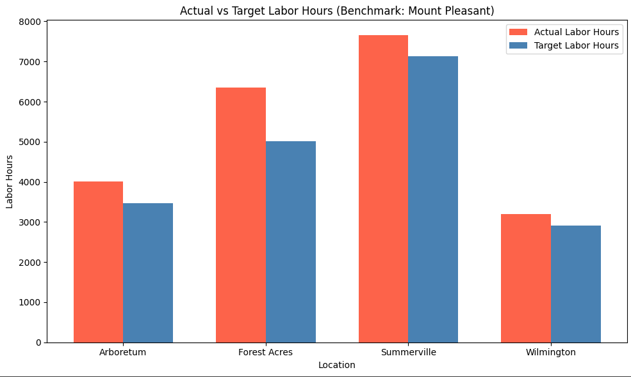
Labor Cost Inefficiencies

Slide 10
Labor Cost Inefficiencies
 | Location | Actual Labor Hours | Target Labor Hours | Hours Saved | Estimated Cost Savings ($)
1 | Arboretum | 4012.21 | 3461.42 | 550.79 | 8261.84
2 | Forest Acres | 6352.59 | 5006.53 | 1346.06 | 20190.94
3 | Summerville | 7650.94 | 7132.39 | 518.54 | 7778.13
4 | Wilmington | 3190.40 | 2903.63 | 286.78 | 4301.67

Slide 11
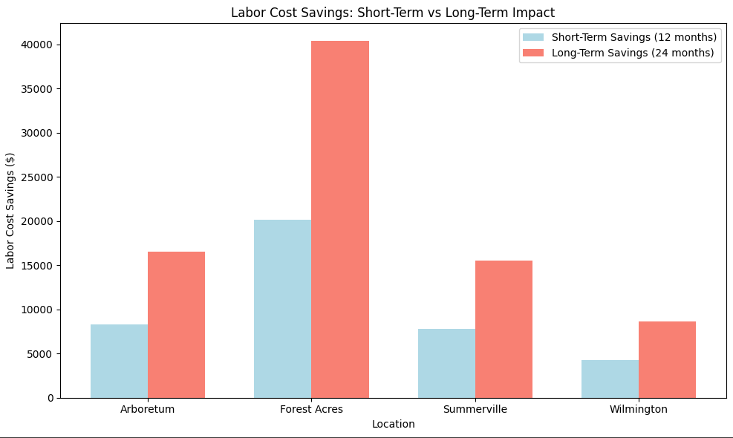
Implementation Plan
Location Short-Term Savings ($) Long-Term Savings ($)
Arboretum 8261.83 16523.67
Forest Acres 20190.95 40381.90
Summerville 7778.13 15556.26
Wilmington 4301.67 8603.34

Slide 12
Implementation Plan
Short-Term
Fewer idle hours = sharper scheduling
Staff is focused more during high-impact sales hours.
Long-Term
Cross-training improves flexibility with fewer people.
Use attrition or reduced hours (not firing) to manage reductions smoothly.
Managers start using metrics to schedule smarter.
Culture shifts toward “work smarter, not longer.”

Slide 13
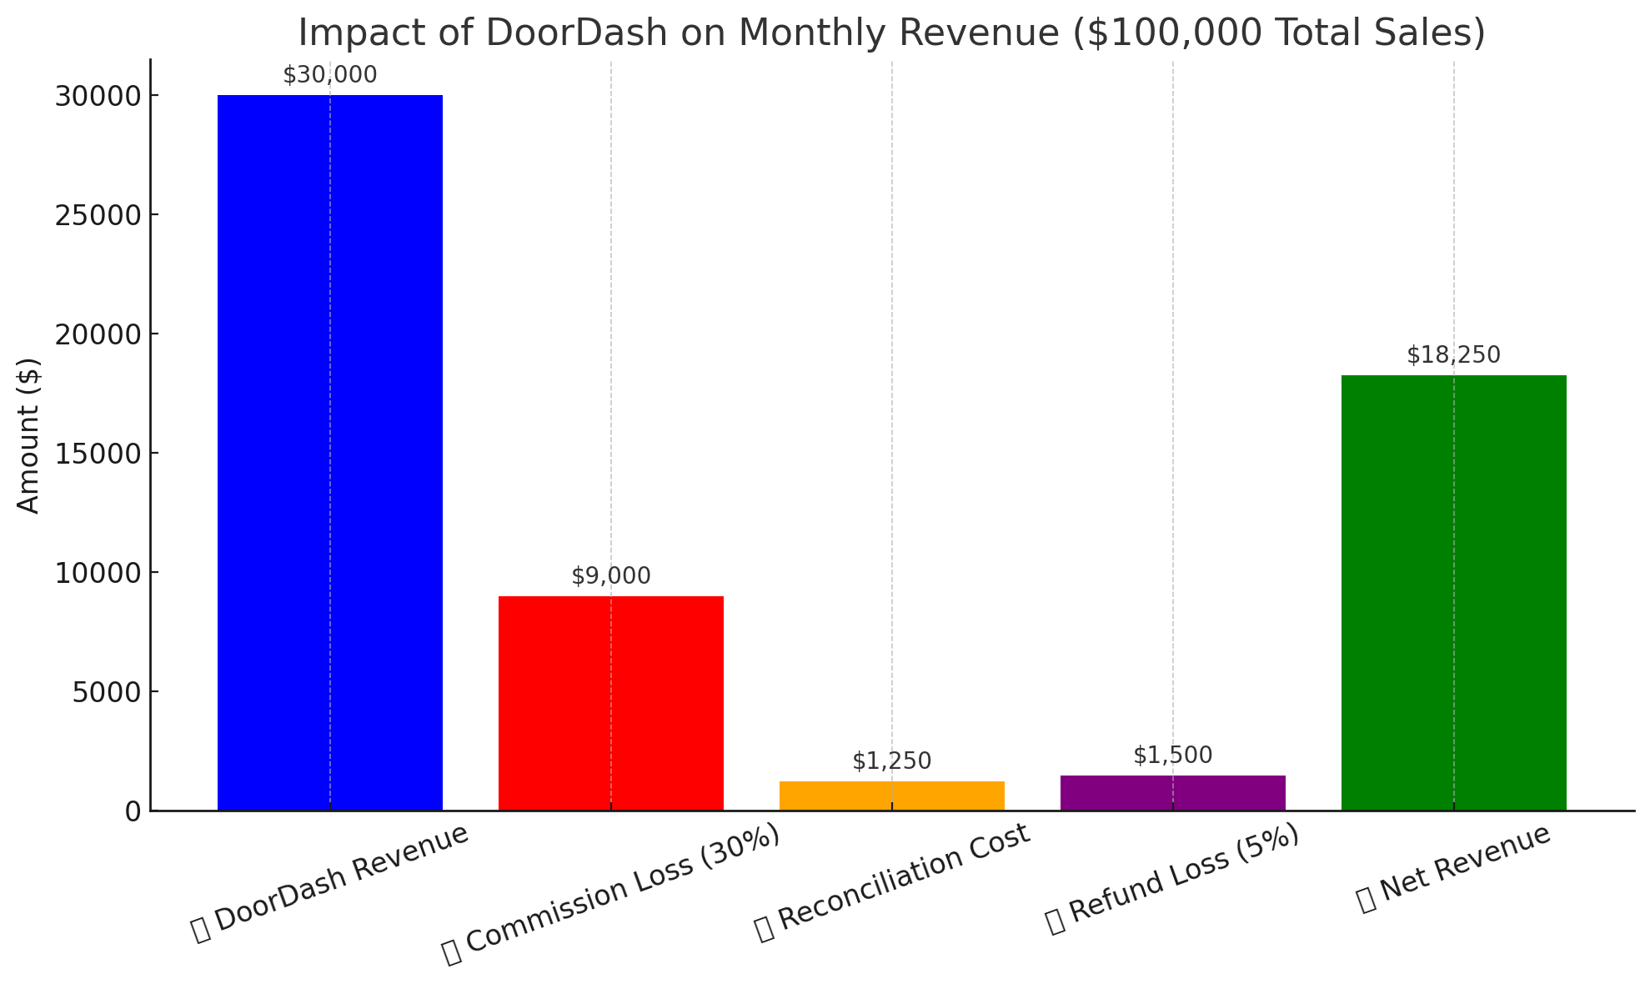
Delivery Platforms Profit Loss
High commission fees kill profit with 30%
Manual reconciliation wastes time
Lack of customer data and loyalty
Delivery fault hurt restaurant income and public image
Notes:
High Fees Kill Profit → 30% commission eats your margins
Chargebacks Customer complaints lower your payout, Bad Deliveries Hurt Your Brand → You get blamed for poor third-party service
Manual Reconciliation Wastes Time → 10 hrs/month/store just to verify payments
No Customer Loyalty → DoorDash keeps the customer and their data, not you

Slide 14
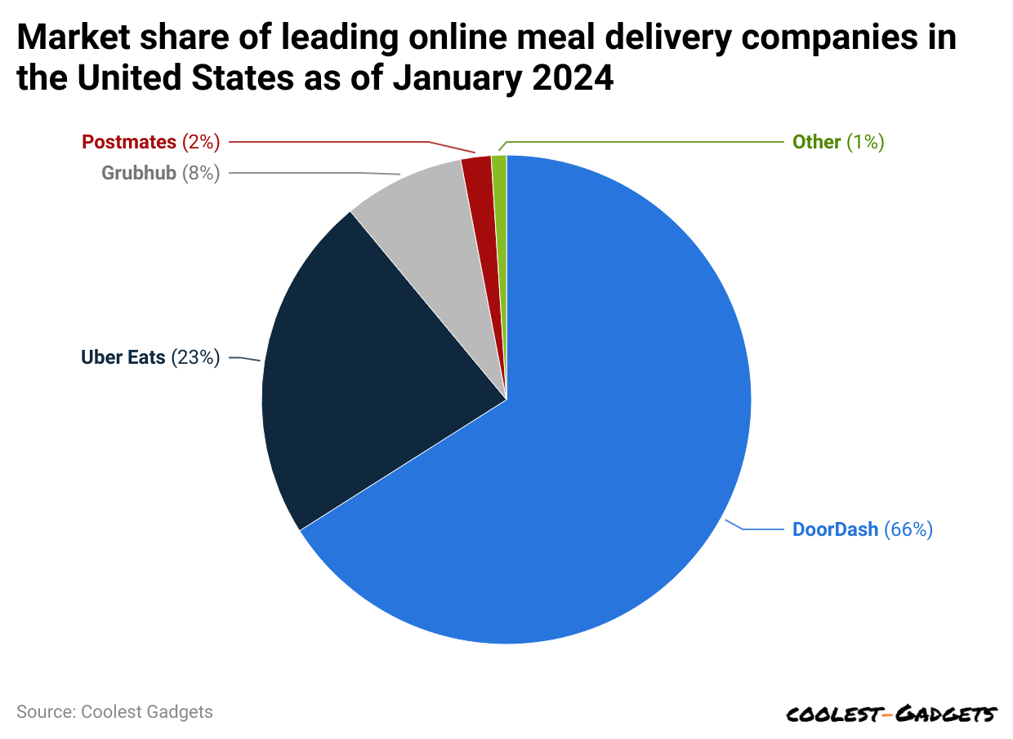
Implementation Plan
Short-Term
Optimize menu profitability on delivery platforms
Reduce reconciliation time
Explore new partnerships
Negotiate better commission rates
Long-Term
Diversify delivery platforms
Build direct channels
Notes:
Short-Term
Optimize Menu Profitability
Slightly reduce food portions and raise DoorDash prices
Use promotions/discounts to make higher prices feel justified
Focus on high-margin, delivery-friendly items
Reduce Reconciliation Time
Use integration tools like ItsaCheckmate or Otter to sync POS and DoorDash
Automate reports to track fees, chargebacks, and payouts
Explore Better Partnerships
Find new partnerships
Negotiate better commission rates or incentives

Slide 15
Conclusion
Rebalance Shifting
Cross-Train Employees
Shift Hours to Peak Times
Optimizing delivery profit
Streamline operations
Expand delivery options

Slide 16
Thank You

